Slide 1

CSET 150
Network Design and Management
Evening Masters Edition
Dr. Mahboob Qaosar
Associate Professor, CSE, RU

Slide 2
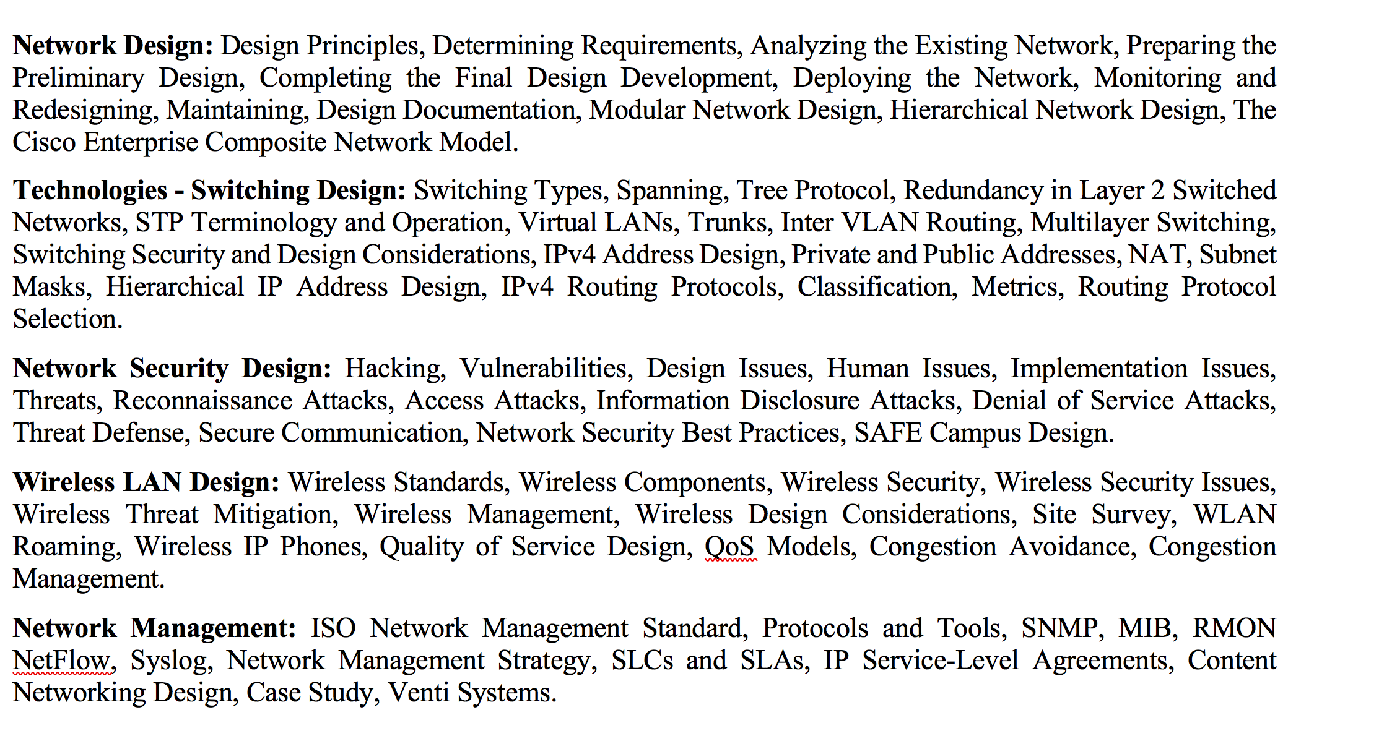
Chapter 3: IPv4 Routing Design

Slide 3
How Routers Use Subnet Masks
When you configure the IP address of a router's interface, you include the address and the subnet mask.
The router uses this information not only to address the interface but also to determine the address of the subnet to which the interface is connected.
The router then puts this subnet address in its routing table, as a connected network on that interface.

Slide 4
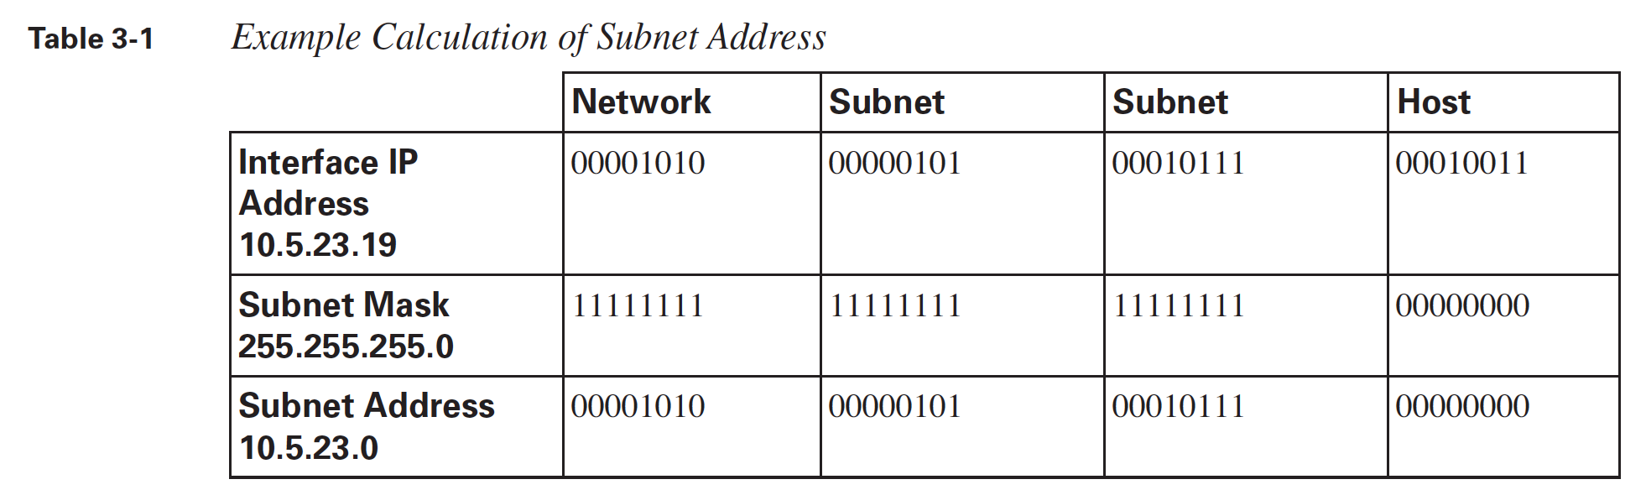
How Routers Use Subnet Masks
To determine the network or subnet address to which a router is connected, the router performs a logical AND of the interface address and the subnet mask. Logically "ANDing" a binary 1 with any number yields that number; logically "ANDing" a binary 0 with any number yields 0.

Slide 5
How Routers Use Subnet Masks
When a packet arrives at the router,
the router analyzes the destination address of the packet to determine which network or subnet it is on.
The router looks up this network or subnet in its routing table to determine the interface through which it can best be reached;
the packet is then sent out of the appropriate router interface.
[If the router does not have a route to the destination subnet, the packet is rejected and an Internet Control Message Protocol (ICMP) error message is sent to the source of the packet.]

Slide 6
Subnet Mask to Use
Determining the Subnet Mask to Use
… depends on the number of subnets required and
the number of host addresses required on each of these subnets

Slide 7
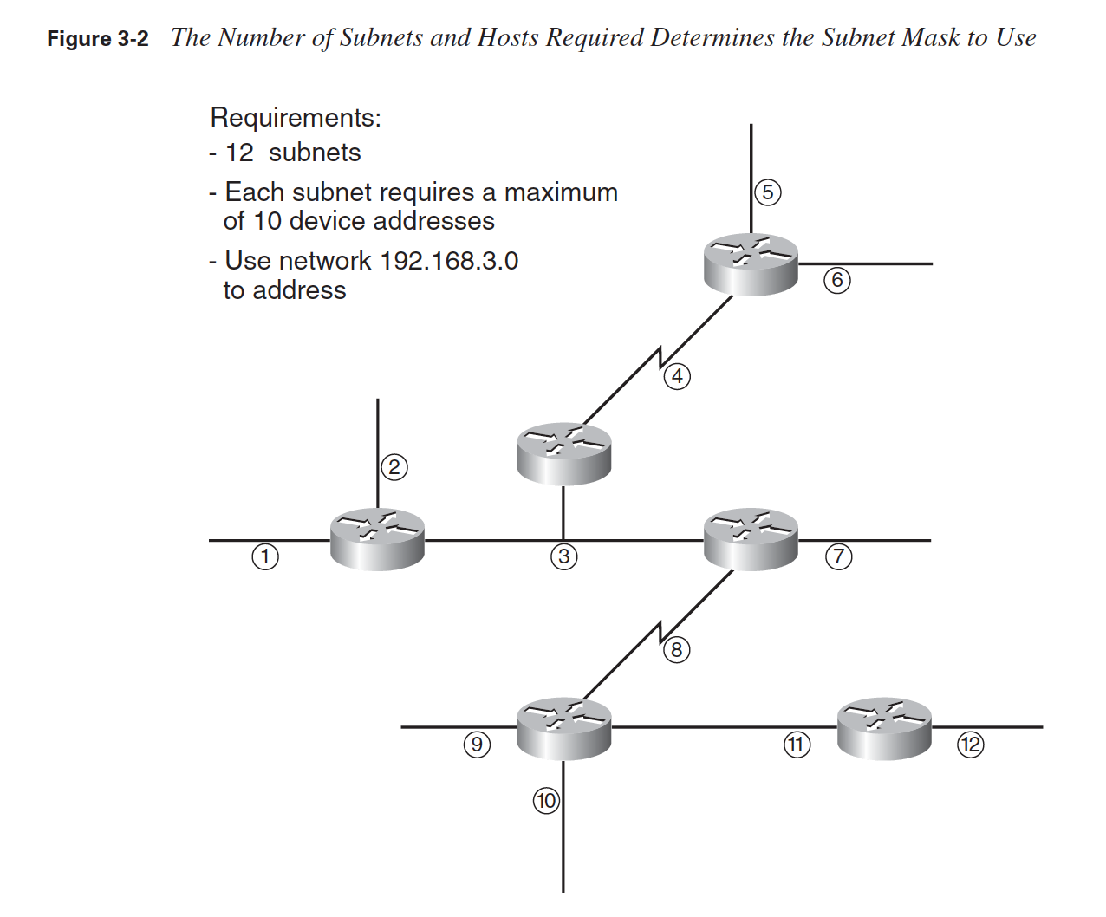
Determining the Subnet Mask to Use
A total of 12 subnets exist in this network;
Each has a maximum of 10 device addresses.
Some of the addresses are for router interfaces and some are for hosts (not shown in the figure);
each device on each subnet needs to have its own IP address.
Select a series : say 192.168.3…

Slide 8
Determining the Subnet Mask to Use
Number of subnet required 🡪 12 🡪 2^4 🡪 4 bits needed
Number of host address required 🡪 10 🡪 2^4 🡪 4bit needed
IPv4 🡪 32 bit – 8 bit . 8 bit . 8 bit . 8 bit
8 bit . 8 bit . 8 bit . 4 bit (Subnet) + 4 bit (Host)
255. 255 . 255. 1111000 🡪 255.255.255.240 – network mask or subnet mask

Slide 9
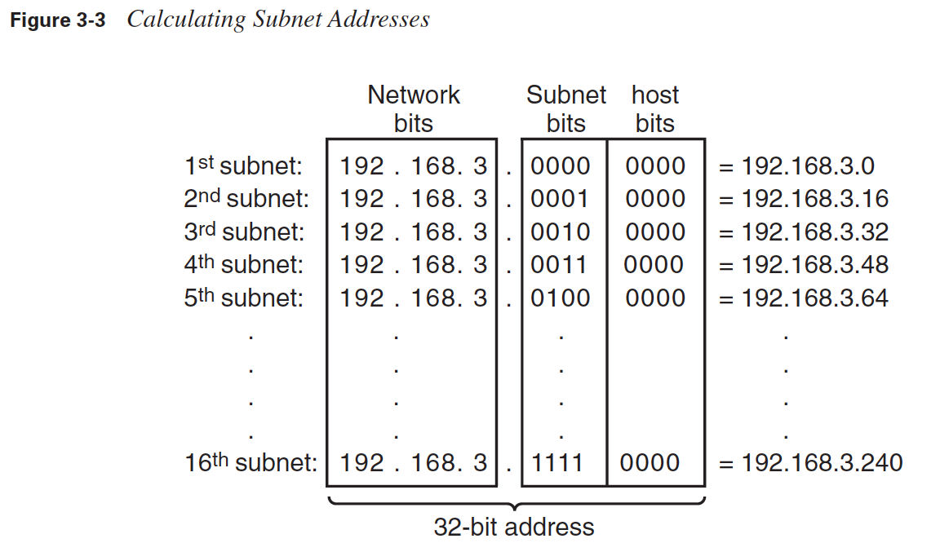
Determining the Subnet Mask to Use
Thus, the first subnet address that can be used with a mask of 255.255.255.240 is 192.168.3.0; this can also be written as 192.168.3.0/28. The second subnet is 192.168.3.16/28, and so on.

Slide 10
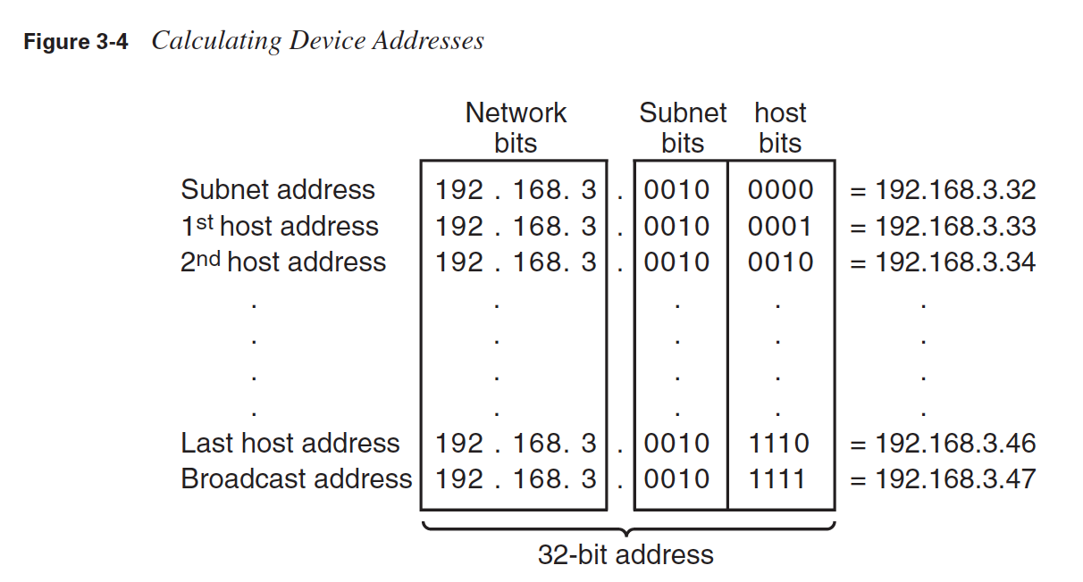
Determining the Subnet Mask to Use
Remember that the address in which all host bits are 0 is the subnet address, and the address in which all host bits are 1 is the broadcast address

Slide 11
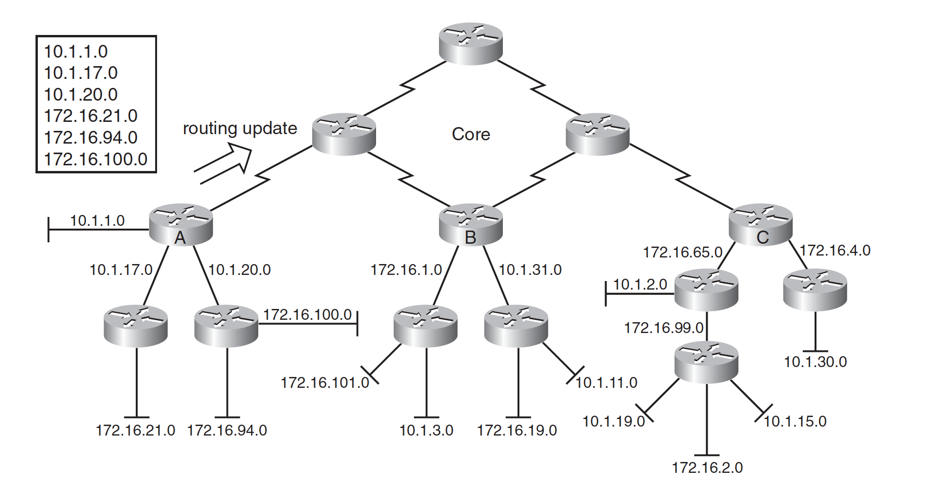
Hierarchical IP Address Design

Slide 12
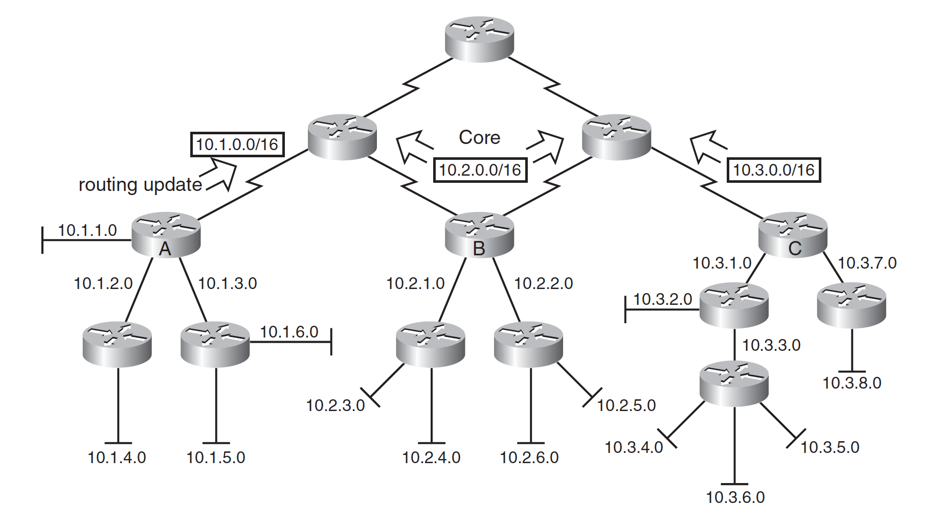
Hierarchical IP Address Design

Slide 13
Hierarchical IP Address Design
Router A
192.168.3.64/28
192.168.3.80/28
192.168.3.96/28
192.168.3.112/28
Router B
192.168.3.0/28
192.168.3.16/28
192.168.3.32/28
192.168.3.48/28.

Slide 14
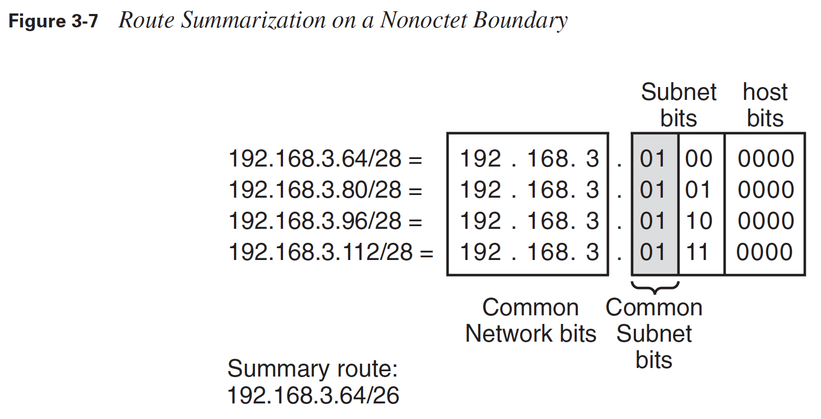
Hierarchical IP Address Design

Slide 15
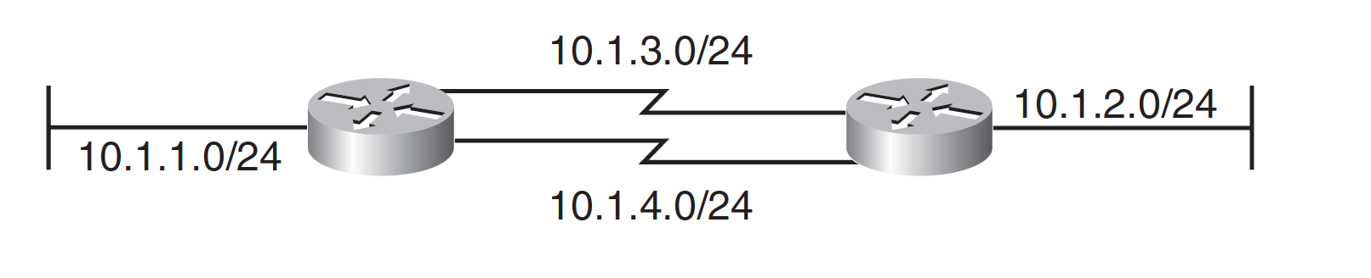

Variable-Length Subnet Masks
Variable-Length Subnet Masks –VLSM

Slide 16
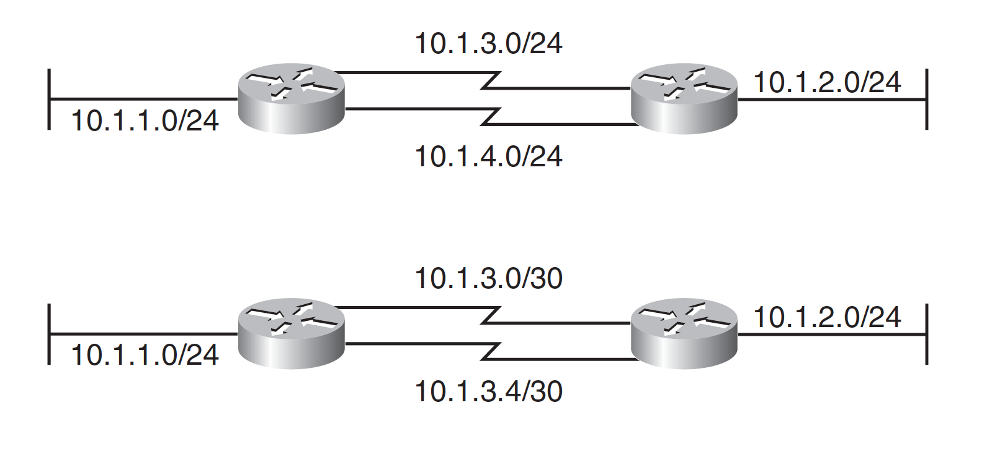
Variable-Length Subnet Masks

Slide 17
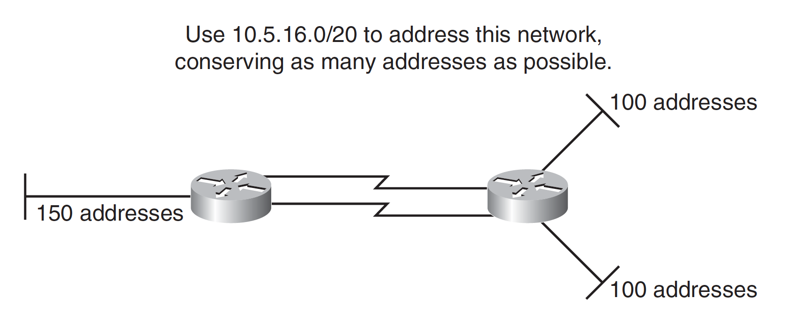
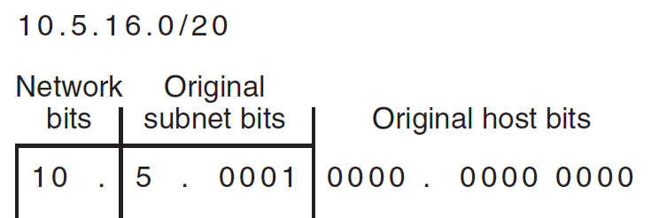
Variable-Length Subnet Masks
If you use any addresses from a subnet, that subnet should not be further subnetted.

Slide 18
For the left LAN, 150 addresses are needed;
rounding up to the next power of 2 gives 256.
Because 2⁸ = 256, 8 host bits are needed.
For the other two LANs, 100 addresses are needed;
rounding up to the next power of 2 gives 128.
Because 2⁷ = 128, 7 host bits are needed for each LAN.
The WANs require 2 host bits each.

Slide 19
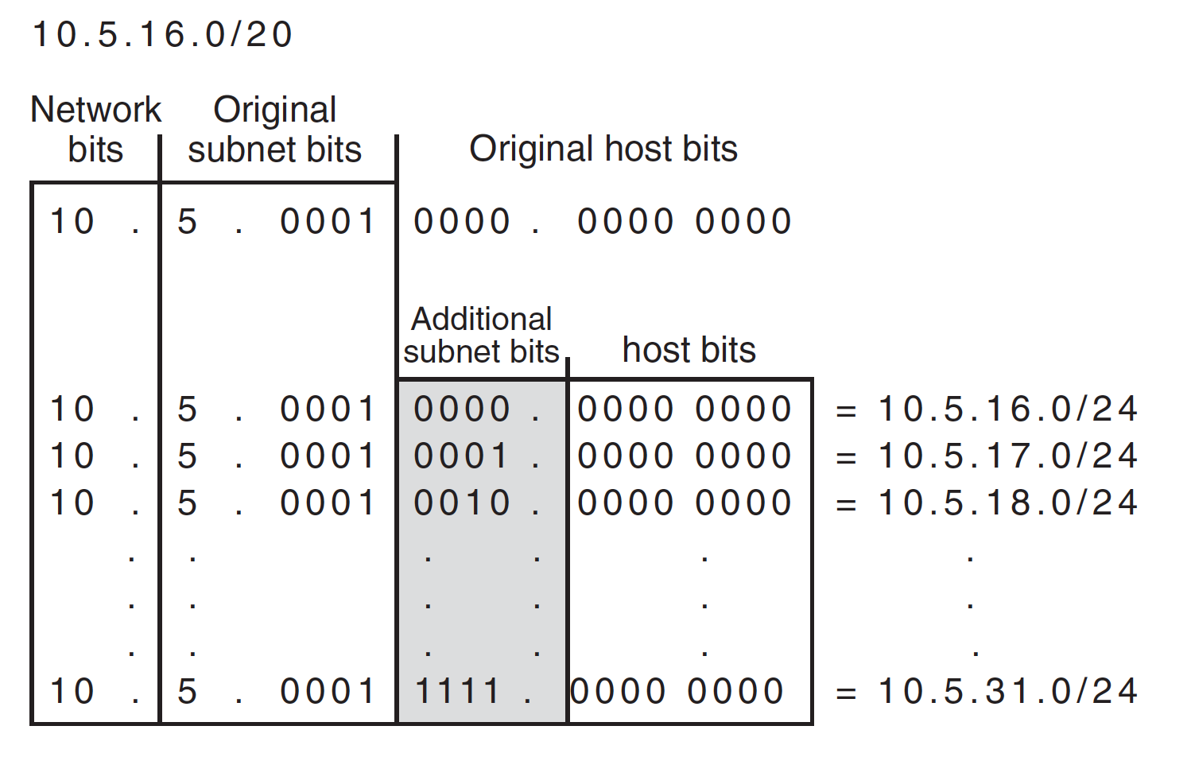
Because at most 8 host bits are needed, the 10.5.16.0/20 address can be further subnetted into sixteen /24 subnets (leaving 8 host bits)

Slide 20
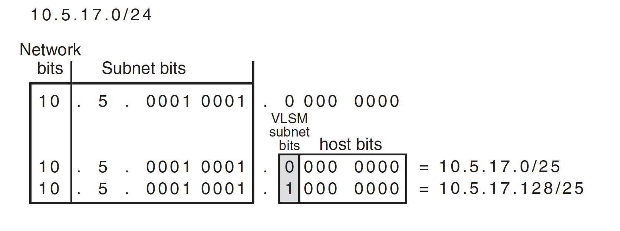

Slide 21
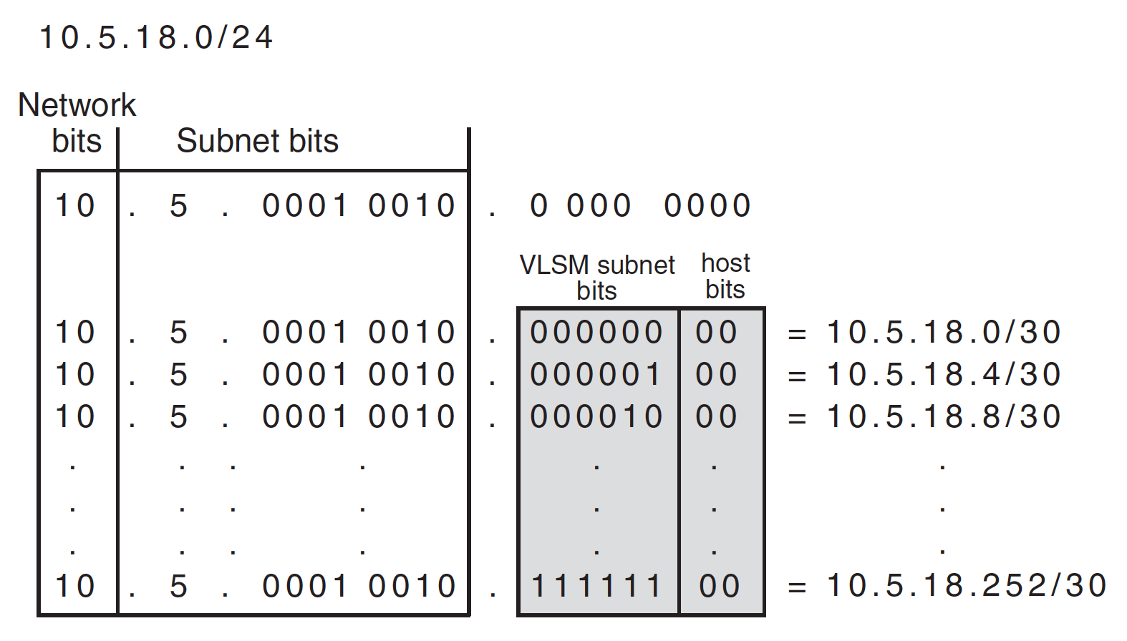
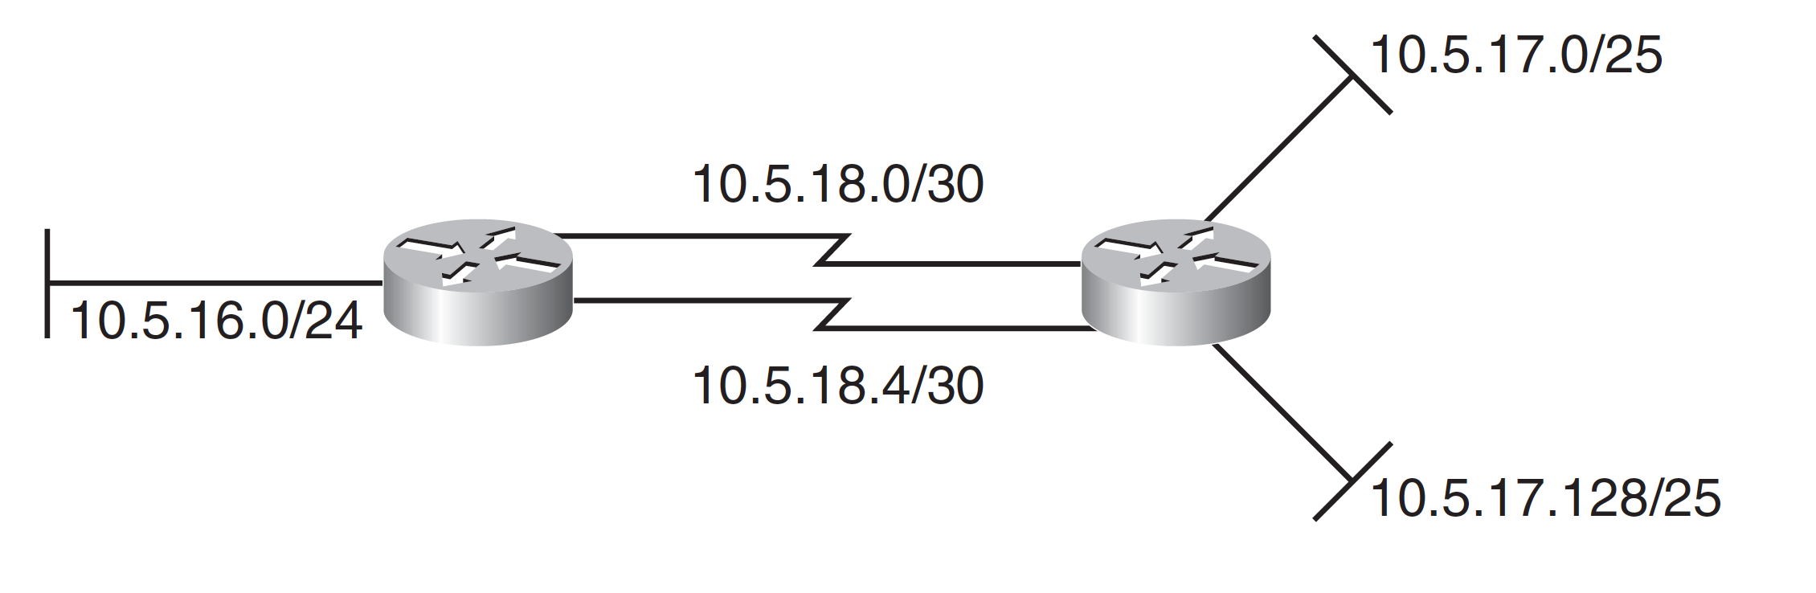
Variable-Length Subnet Masks

Slide 22
Report Submission
150 addresses
100 addresses
150 addresses

Slide 23
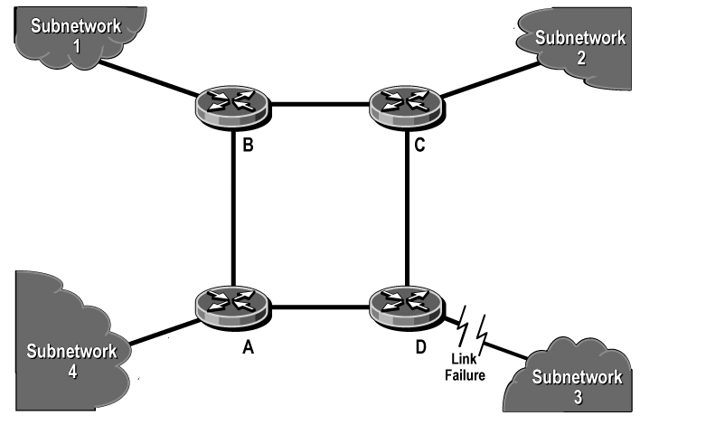
IPv4 Routing Protocols
The main functions of a router are:
first to determine the best path that each packet should take to get to its destination, and
second to send the packet on its way
To determine the best path on which to send a packet,
a router must know where the packet's destination network is.
192.168.3.0/24
10.1.1.0/24
172.16.2.0/24

Slide 24
IPv4 Routing Protocols
It can be mentioned by network administrator
Routes configured by network administrators are known as static routes
Routes to which a router is physically connected are known as directly connected routes.
Routers learn routes from other routers by using a routing protocol.

Slide 25
Classifying Routing Protocols
Can be classified in various ways
Interior and Exterior Routing Protocols
Distance Vector, Link-State and Hybrid Routing Protocols
Flat and Hierarchical Routing Protocols
Classful and Classless Routing Protocols

Slide 26
Interior and Exterior Routing Protocols
Autonomous - independent
An autonomous system (AS) is a network controlled by one organization;
it uses interior routing protocols, called interior gateway protocols (IGPs) within it, and
exterior routing protocols, called exterior gateway protocols (EGPs), to communicate with other autonomous systems.

Slide 27
Distance Vector, Link-State, and Hybrid Routing Protocols
Distance vector routing protocol
All the routers send their routing tables to only their neighboring routers.
The routers then use the received information to determine whether any changes need to be made to their own routing table
The process repeats periodically.

Slide 28
Distance Vector, Link-State, and Hybrid Routing Protocols
In a link-state routing protocol,
each of the routers sends the state of its own interfaces (its links) to all other routers (*) only when there is a change to report.
(or to all routers in a part of the network, known as an area)
Each router uses the received information to recalculate the best path to each network and then saves this information in its routing table.

Slide 29
Distance Vector, Link-State, and Hybrid Routing Protocols
A Hybrid protocol
As its name suggests, a hybrid protocol borrows from both distance vector and link-state protocols.
Hybrid protocols send only changed information (similar to link-state) but only to neighboring routers (similar to distance vector).

Slide 30
Distance Vector, Link-State, and Hybrid Routing Protocols
Link-state routers have knowledge of the entire network, while distance vector routers only know what their neighbors tell them.
Routers running distance vector routing protocols typically send updates in broadcast packets, while those running link-state and hybrid routing protocols send the updates in multicast packets

Slide 31
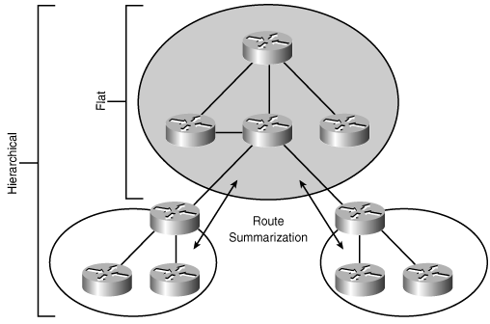
Flat and Hierarchical Routing Protocols
Flat routing protocols have no way to restrict routes from being propagated within a major network (a Class A, B, or C network).
In contrast, hierarchical routing protocols allow the network administrator to separate the network into areas and limit how routes are propagated between areas.
This in turn reduces the routing table size and amount of routing protocol traffic in the network.

Slide 32
Classful and Classless Routing Protocols
Classful addressing is obsolete and has not been used in the Internet since the implementation of Classless Inter-Domain Routing (CIDR) starting in 1993.
Routing updates sent by a Classful routing protocol do not include the subnet mask.
Routing updates sent by a classless routing protocol include the subnet mask.

Slide 33
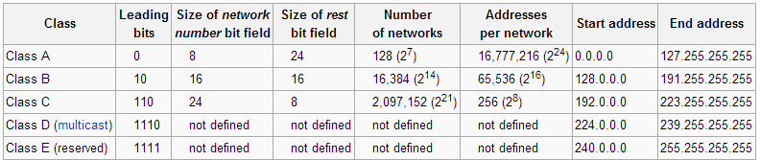
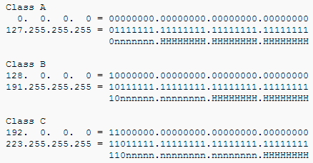
Classful and Classless Routing Protocols

Slide 34
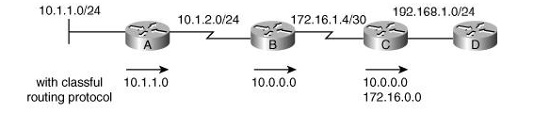
Classful and Classless Routing Protocols
Router B assumes that the mask of the 10.1.1.0 route sent by Router A must be the same as the mask on the 10.1.2.0 subnet to which it is connected, because the mask is not sent along with the route.
Router B summarizes all subnets of network 10.0.0.0 when it sends routing information to Router C because it is sending the route on an interface that is in a different major network.
For the same reason, Router C summarizes network 172.16.0.0 when it sends routing information to Router D.

Slide 35
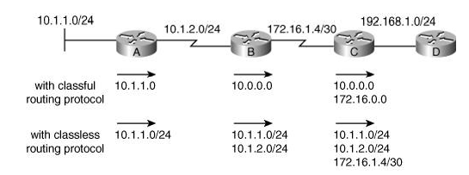
Classful and Classless Routing Protocols

Slide 36
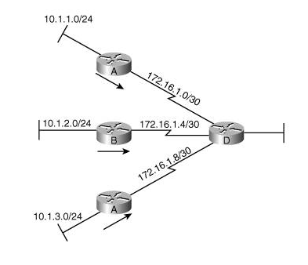
Classful and Classless Routing Protocols
Classful Routing Protocols Do Not Support Discontiguous Networks;
Classless Routing Protocols Do
10.1.1.0 🡪No local interface 🡪 Class A Network
🡪First 8bit subnet mask 🡪routing table 10.0.0.0

Slide 37
Classful and Classless Routing Protocols
The IP address design implications of using a classful routing protocol are as follows:
All subnets of the same major network must use the same subnet mask.
All subnets of the same major network must be contiguous;
in other words, all subnets of the same major network must be reachable from each other without going through a part of any other major network.
Classful routing protocols automatically summarize routes on the major network boundary.

Slide 38
Metrics
One of a router's jobs is to determine the best path to each destination network.
The routing protocol metric is the value that the routing protocol uses to evaluate which path is best.
Metrics can include the following factors:
Hop count
Bandwidth
Delay
Cost
Load
Reliability

Slide 39
Metrics
Hop count
The number of hops, or other routers, to the destination network; the path with the least number of hops is preferred.
Bandwidth
The path with the lowest bandwidth segment is the least preferred path.
Delay
The path with the lowest accumulated delay (also called latency) is the preferred path.
Cost
Usually inversely related to bandwidth; in other words, the path with the slowest links has the highest cost and is the least preferred path.

Slide 40
Metrics
Load
The utilization of the path (in other words, how much of the bandwidth is currently being used).
For example, in the Cisco Interior Gateway Routing Protocol (IGRP) and Enhanced Interior Gateway Routing Protocol (EIGRP) metrics, load can be included as a number from 0 to 255, representing a 5-minute exponentially weighted average load. Load is not included by default in these calculations because it can be constantly changing.
Reliability
The likelihood of successful packet transmission.
For example, in IGRP and EIGRP metrics, reliability can be included as a number from 0 to 255, with 255 meaning 100 percent reliability and 0 meaning no reliability. Reliability is not included by default in these calculations because it can change often (for example, with heavy traffic load).

Slide 41
Convergence Time
A network is converged when the routing tables in all the routers are synchronized so that they all contain a usable route to every available network.
Convergence time is the time it takes all the routers in a network to agree on the network's topology, after that topology has changed.
Network design impacts convergence time significantly; in fact, proper network design is a must, or else the network might never converge.

